Slide 1
NCSA Fall Hackathon 11/10/2019 Team 1B
Hongyu Shen , William Wei , Asad Khan , Shirui Luo , Madhu Vellakal

Slide 2
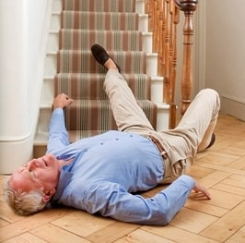
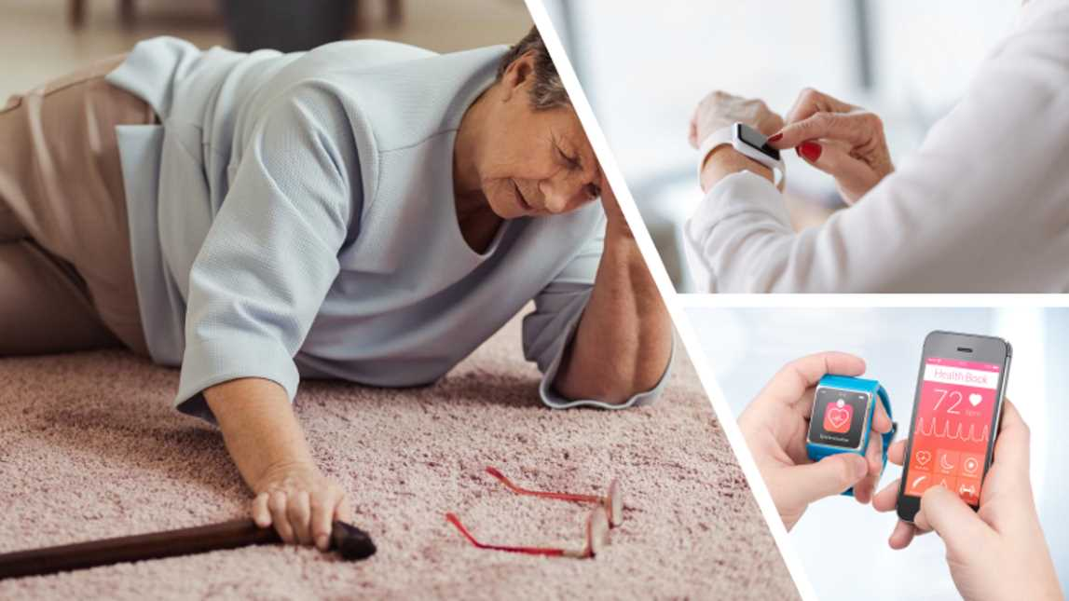
Fall Detection
On an average ~30%, people >65 fall
Healthcare costs total upto US$55 billion by 2020
Fall detection systems are need of the hour
Major types – wearable sensors, vision devices
https://happyseniors.care/en/technology/fall-detection-and-prevention-systems/
https://medicalalertsystemreviews.net/automatic-fall-detection-alert/

Slide 3
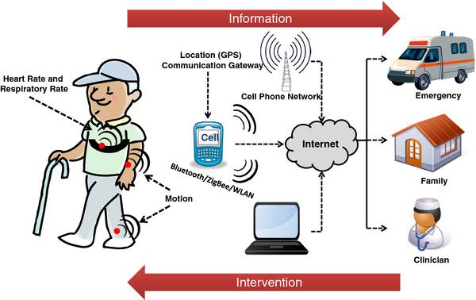
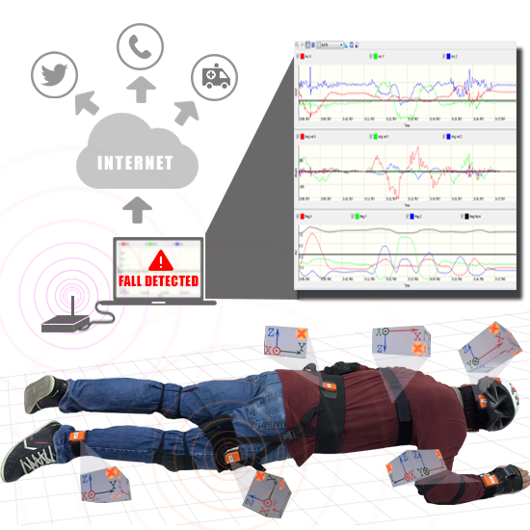
Wearable Sensors
Intrusive
Prediction based on accelerometer and threshold based algorithms
Poor differentiation between activities of daily living (ADLS) and falls
A review of wearable sensors and systems with application in rehabilitation, Patel et.al
Detecting Falls with Wearable Sensors Using Machine Learning Techniques, Ozdemir et.al

Slide 4
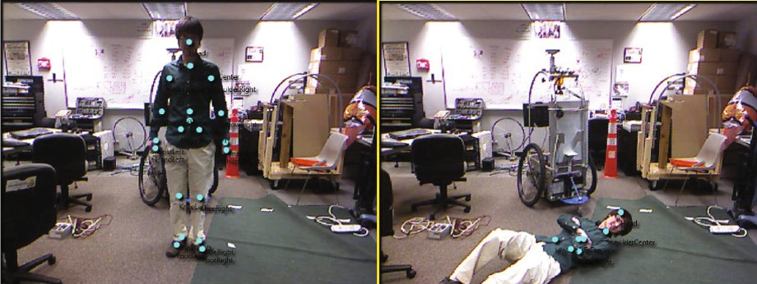
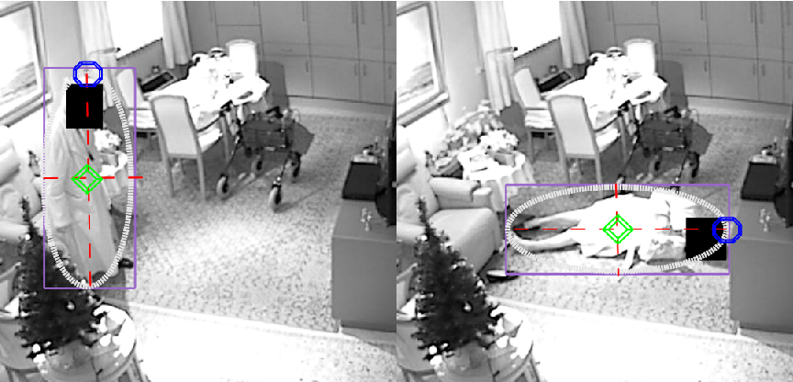
Vision Devices
Non-intrusive
Multi-mode data capture – angle, cameras, activities
Remote verification of events
https://visl.technion.ac.il/projects/2014s08/
Camera-Based Fall Detection on Real World Data, Glen Debard, Peter Karsmakers, Debard et.al

Slide 5
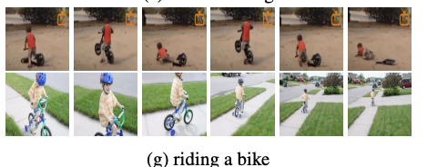
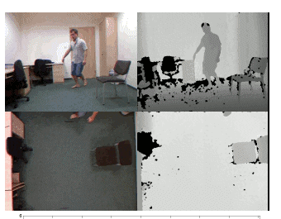
Datasets
UR Fall Detection Dataset
70 videos – 30 falls and 40 ADL’s (Activity of Daily Living)
Kinetic Human Action Video Dataset (ADL’s, or non-fall’s)
400 class of actions, 400 clips per action
Multiple Cameras Fall Dataset
http://fenix.univ.rzeszow.pl/~mkepski/ds/uf.html
https://arxiv.org/pdf/1705.06950.pdf

Slide 6
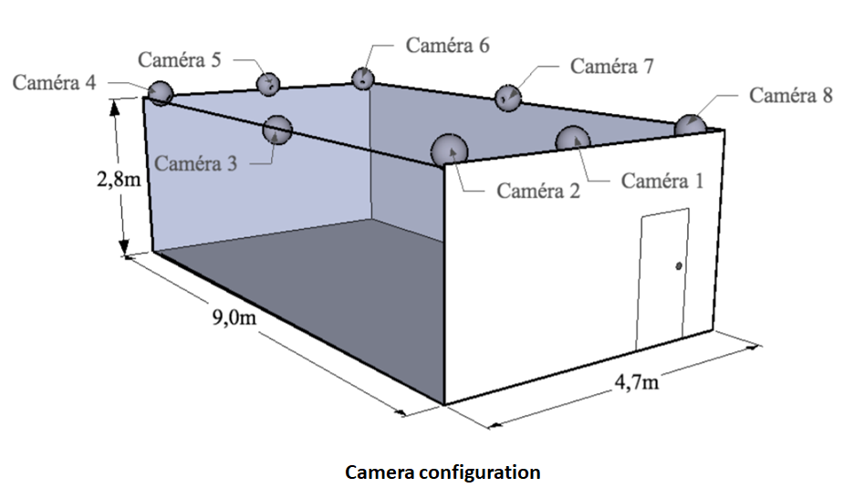
Multiple Cameras Fall Dataset
24 scenarios, each scenario has 8 cameras from different angles, in total 24 X 8 = 192 videos
Each videos have 1000 ~ 5000 frames of images, with ~30 images are falling images

Slide 7
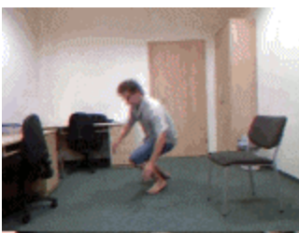
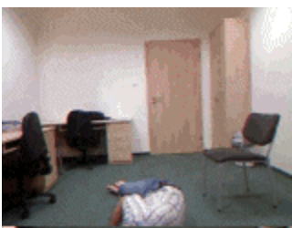
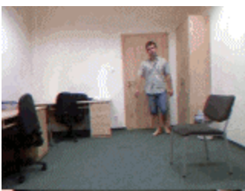
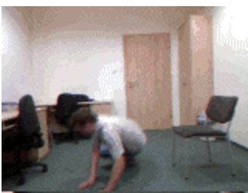
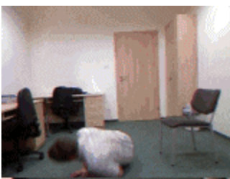
Data Preparation
Data split (works in RGB videos and optical flow)
With “Fall” Labelled
(ADL’s don’t have )
Time Line
Sliding Window
Sliding Window
Sliding Window
Sliding Window
Sliding Window

Slide 8
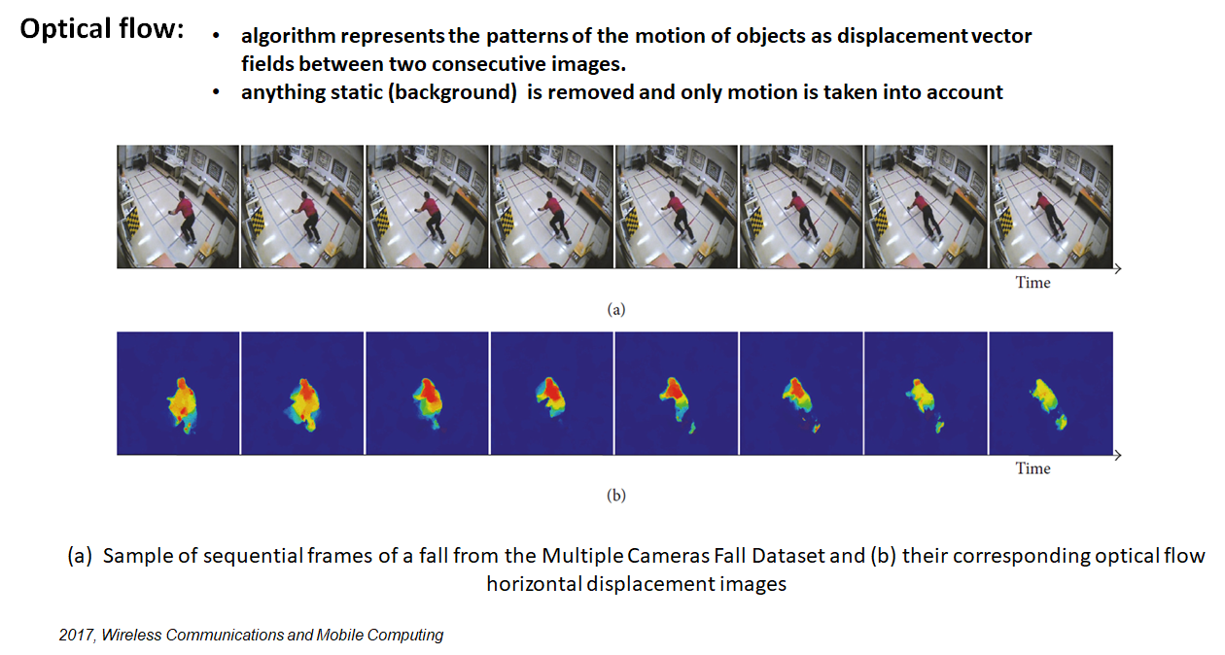

Slide 9
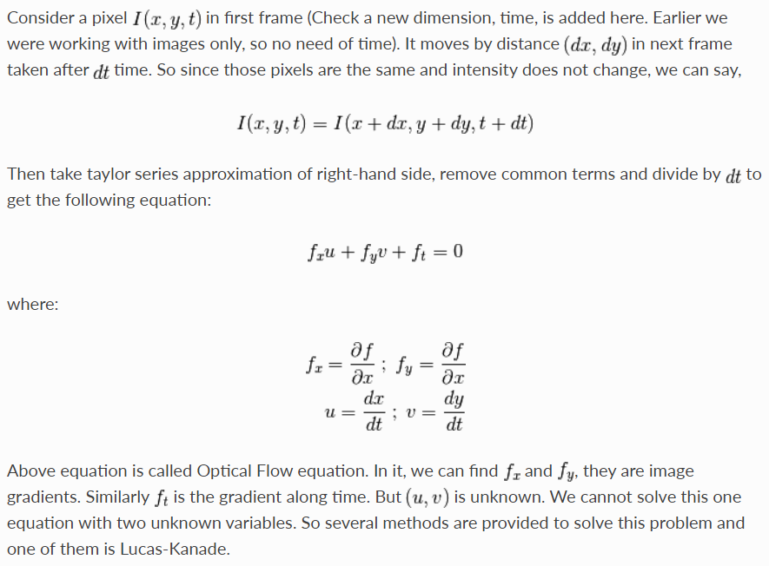
Optimal Flow Algorithm: Gunnar Farneback
Change RGB color to HSV(hue、saturation、value)

Slide 10

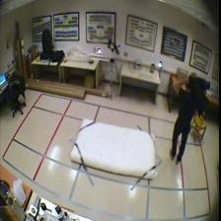
First scenario

Slide 11
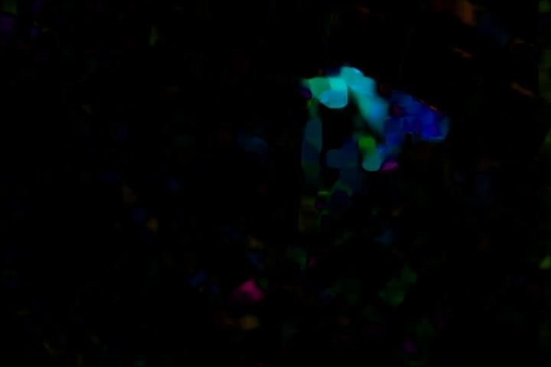
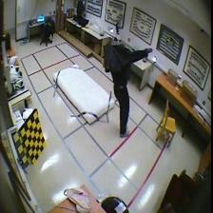
Same scenario but from different angle

Slide 12
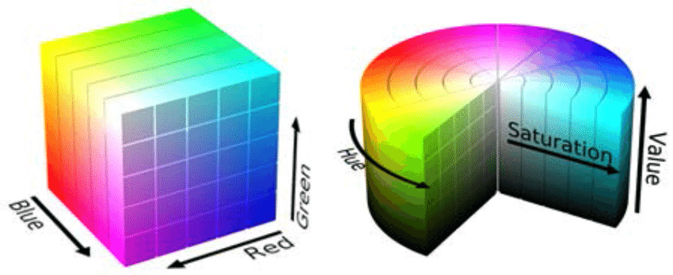
RGB vs HSV (hue, saturation, value)
Unlike RGB, HSV separates luma, or the image intensity, from chroma or the color information.
In computer vision you often want to separate color components from intensity for various reasons, such as robustness to lighting changes, or removing shadows.
Algorithm less sensitive (if not invariant) to lighting variations

Slide 13
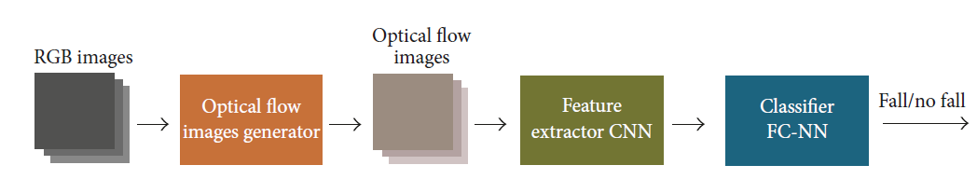
CNN with Optical Flow
2017 Vision-Based Fall Detection with Convolutional Neural Networks
Based on VGG-16 network;
Pretrained with ImageNet;
Calculate optical flow images of UCF101 action dataset;
Retrain with optical flow images;
Data size - 224 X 224 patch, stack size - 20;
Apply transfer learning on UR Fall Detection Dataset .

Slide 14
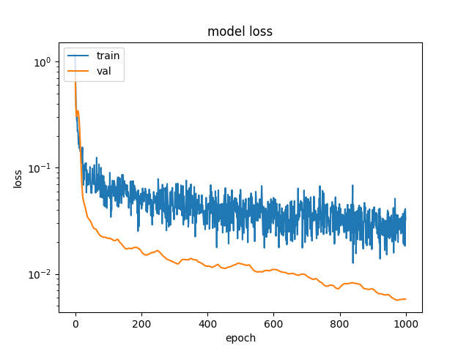
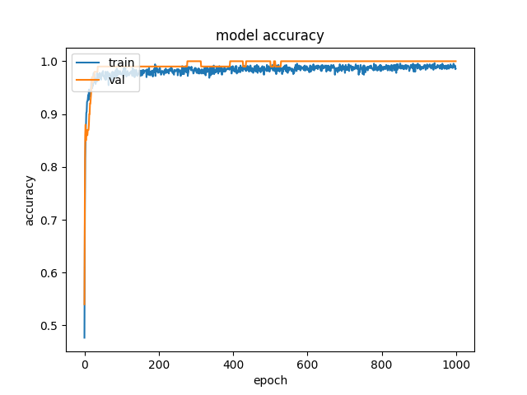
Performance Metrics
Sensitivity - 1.00 (+/- 0.01)
Specificity - 0.99 (+/ -0.01)
FAR - 0.01 (+/ - 0.01)
MDR - 0.00 (+/ - 0.01)
Accuracy - 0.99 (+/ - 0.01)

Slide 15
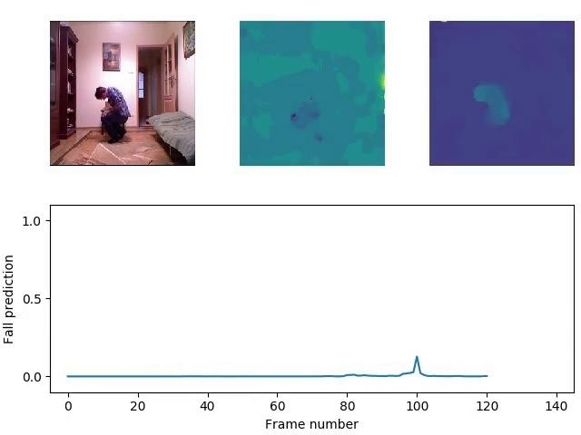

Slide 16
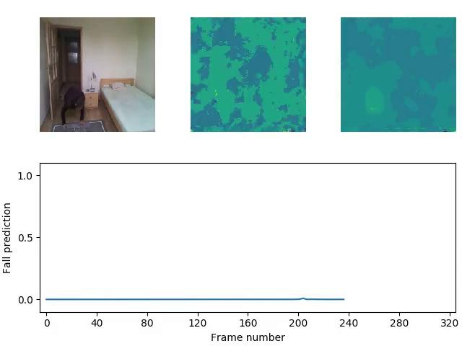

Slide 17
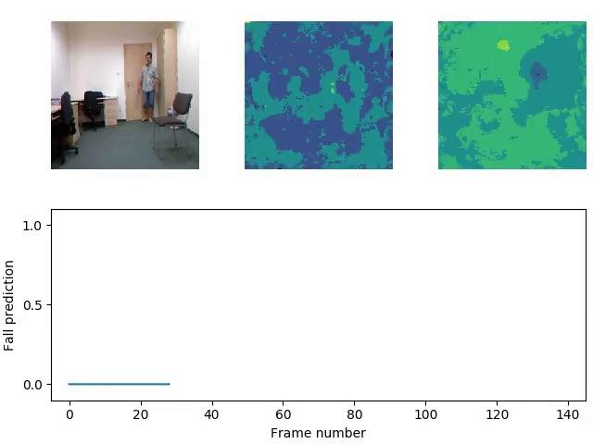

Slide 18
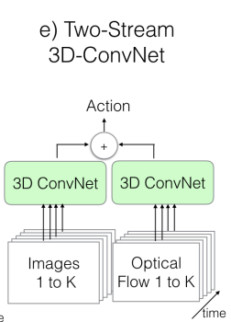
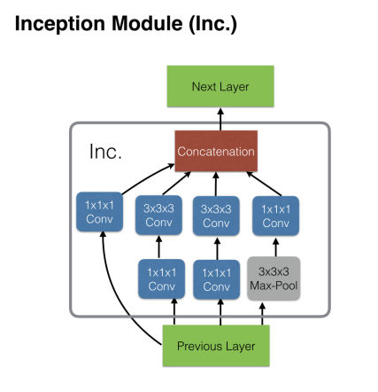
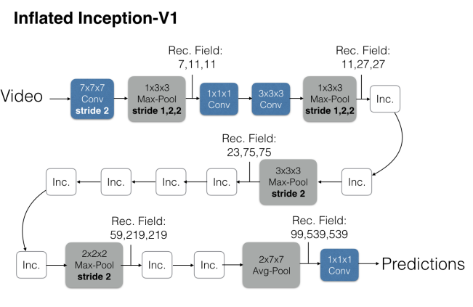
Two-Stream Inflated 3D ConvNet (I3D)
Model:
I3D based on Inception v1 [pretrained on ImageNet]
filters and pooling kernels of deep image ConvNets are expanded into 3D
learns spatio-temporal features extracted from video
Pre-training Data: Kinetics-400. 400 human action classes with more than 400 examples for each class, each from a unique YouTube video.
[1] Quo Vadis, Action Recognition? A New Model and the Kinetics Dataset

Slide 19
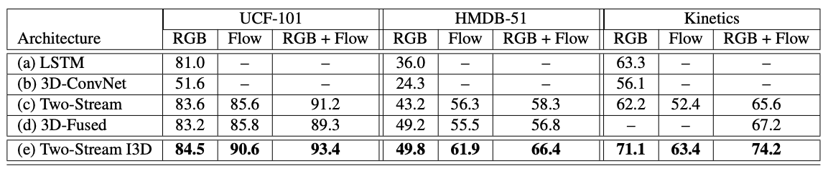
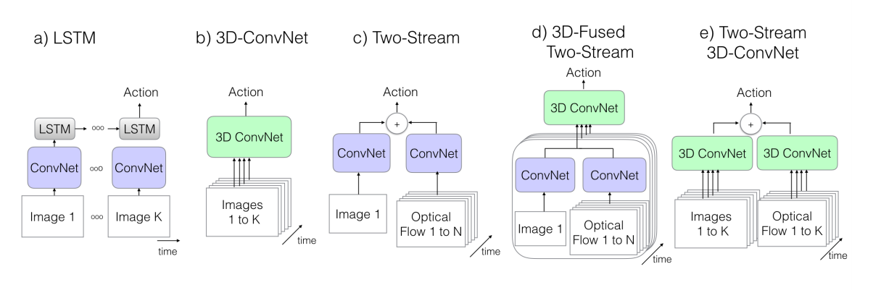
Two-Stream Inflated 3D ConvNet (I3D)
Model:
I3D based on Inception v1 [pretrained on ImageNet]
filters and pooling kernels of deep image ConvNets are expanded into 3D
learns spatio-temporal features extracted from video
Pre-training Data: Kinetics-400. 400 human action classes with more than 400 examples for each class, each from a unique YouTube video.
[1] Quo Vadis, Action Recognition? A New Model and the Kinetics Dataset

Slide 20
Thanks !

Slide 21
Neural Networks
Convolution Neural Networks – powerful model for Image Recognition
Based on that, CNN’s are being used to detect fall
Work with images
Learns the features during the training

Slide 22
Datasets
UR Fall Detection Dataset
70 videos – 30 falls and 40 ADL’s
Fall – Kinect and accelerometer
ADL’s – Camera and accelerometer
Kinetic Human Action Video Dataset
Large database
400 class of actions, 400 clips per action

Slide 23
Neural network model: I3D
3D CNN based - Two Stream Inflated 3D ConvNets(I3D)
Inflation on top of existing state of the art
Inception-V1 as base network
Pretrained with ImageNet
Layers - Convolution, Batch Normalization, ReLU activation function
Data size - 256 pixels, random 224 X 224 patch, 3 Channels (RGB)

